Slide 1
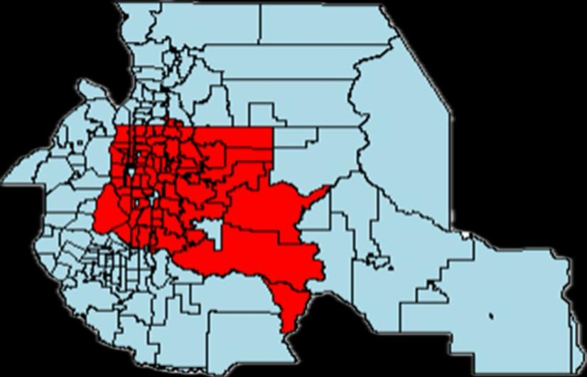
Housing Price Dynamics in King County, WA
Gizem Gulsiye Guleli
Mehmet Tiryaki
Danila Quintero Narvaez

Slide 2
PACKAGES
pandas: data manipulation and analysis
matplotlib: the creation of static, interactive, and animated visualizations in Python, offering flexibility in generating various types of plots.
numpy: for numerical computing and mathematical operations
Seaborn: a high-level interface for creating aesthetically pleasing statistical graphics, the visualization of complex data patterns.
geopandas: An extension of pandas, it enables working with geospatial data by providing support for geometric operations and spatial data visualization.
Notes:
pandas: Used for data manipulation and analysis, particularly for handling tabular data structures such as dataframes.
matplotlib: Employed for creating static, interactive, and animated visualizations in Python, providing flexibility in generating various types of plots.
numpy: Essential for numerical computing and mathematical operations on arrays and matrices, serving as a fundamental library for scientific computing tasks.
Seaborn: Built on top of matplotlib, it offers a high-level interface for creating aesthetically pleasing statistical graphics, facilitating the visualization of complex data patterns.
geopandas: An extension of pandas, it enables working with geospatial data by providing support for geometric operations and spatial data visualization.

Slide 3
DATA
# All variables
all_vars = ["id", "bathrooms", "bedrooms", "condition", "date", "floors", "grade", "lat", "long", "price", "sqft_above", "sqft_basement", "sqft_living", "sqft_living15", "sqft_lot", "sqft_lot15", "view", "waterfront", "yr_built", "yr_renovated", "zipcode"]
# Continuous Numeric Variables
cont_vars = ["price", "sqft_living", "sqft_living15", "sqft_lot", "sqft_lot15", "sqft_above", "sqft_basement"]
# Discrete Numeric Variables
disc_vars = ["bedrooms", "floors", "bathrooms"]
# Categorical Variables
cat_vars = ["waterfront", "view", "condition", "grade"]
# Date Variables
date_vars = ["date", "yr_built", "yr_renovated"]
# Geographical Variables
geo_vars = ["lat", "long", "zipcode"]
**Source:** Kaggle
**Variables:** 21
**Observations:** 21.613
**Period:** 02 May 2014 to 27 May 2015
**Geographic Cov:** King County, Seattle

Slide 4
Exploratory Data Analysis (EDA)

Slide 5
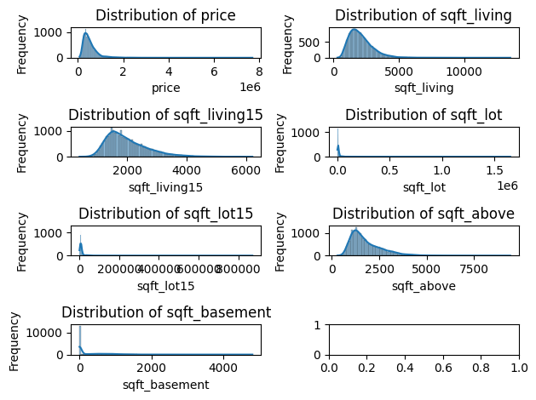

Slide 6
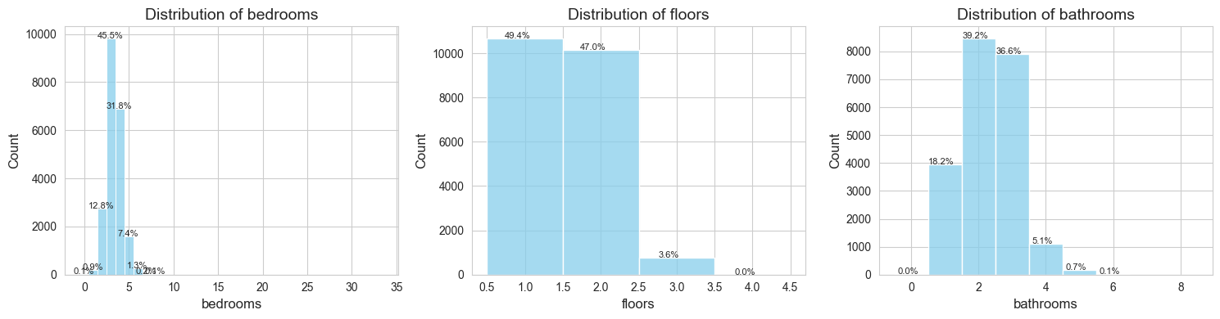

Slide 7
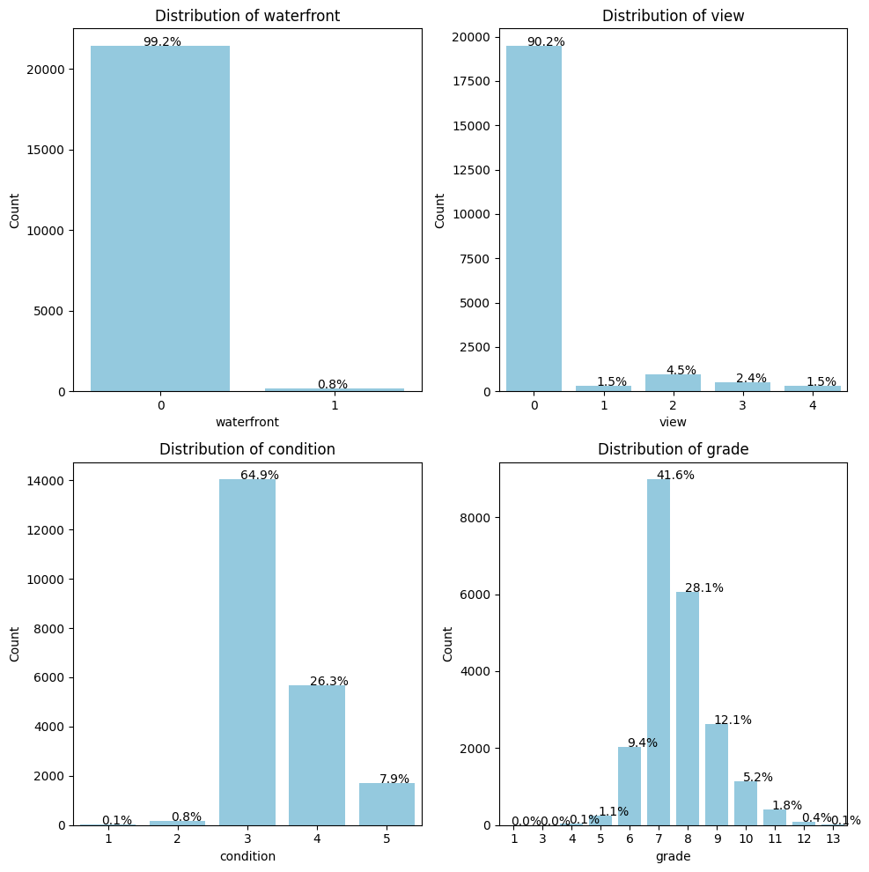

Slide 8
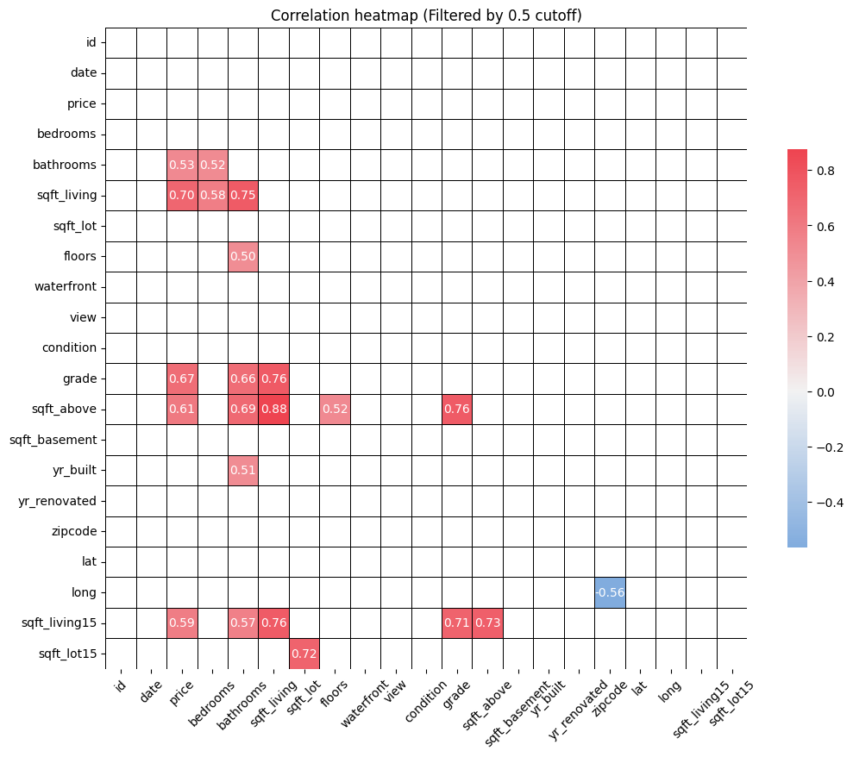

Slide 9
Advanced Visualization Techniques

Slide 10
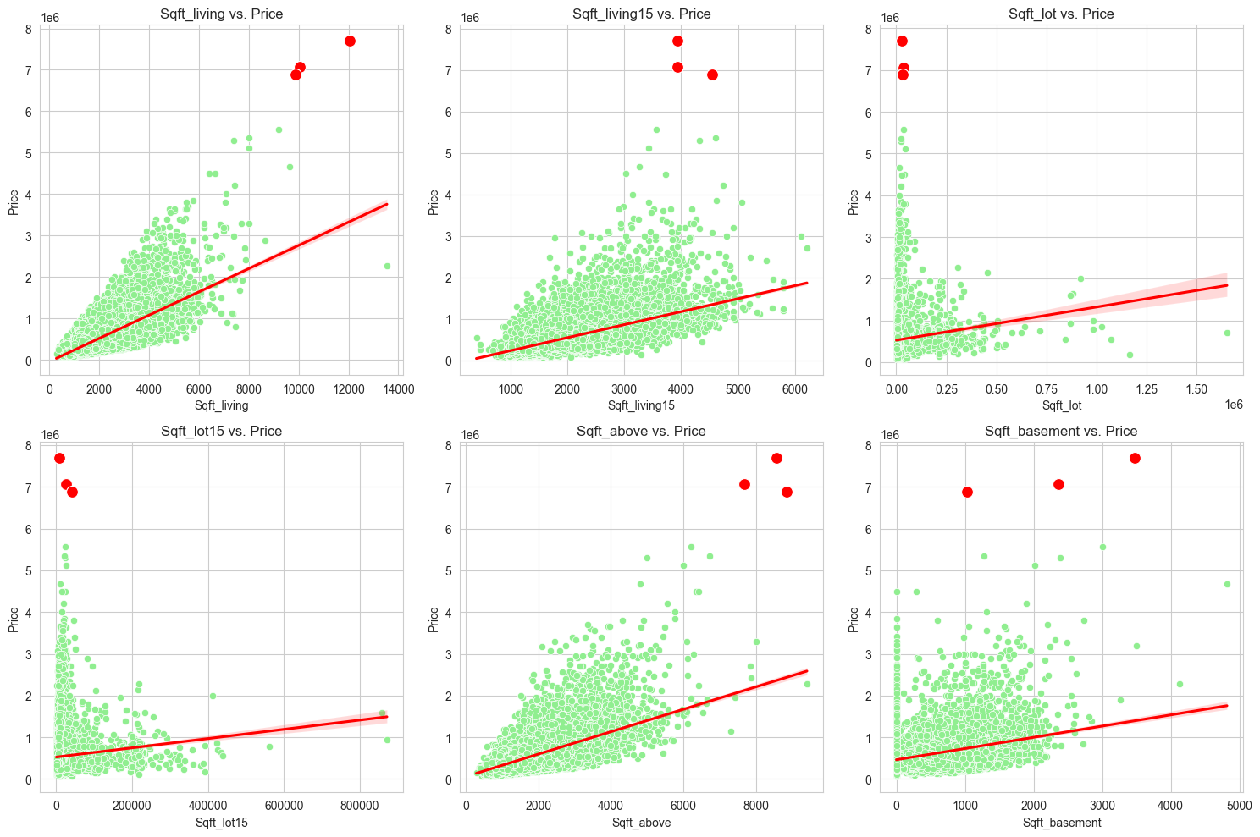

Slide 11
Geospatial Visualization

Slide 12
ML MODELS FOR PREDICTION

Slide 13
Thank You !!!

